Slide 1








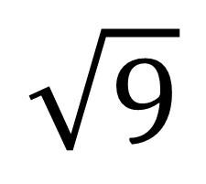
My Angles
Interactive Notebook
Name
Class:
Teacher:
Term 4 Semester 2

Slide 2
Contents
Glossary or Formula Page
Page
Date
Description
2

Slide 3
Tasks
24
7
30
Essential Question
Questions
Notes
Summary
6

Slide 4
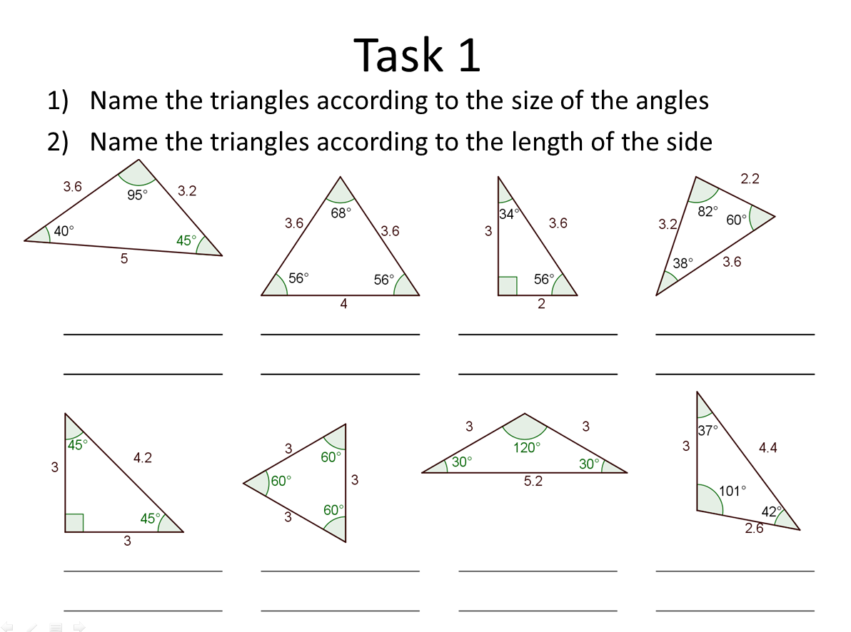

Slide 5
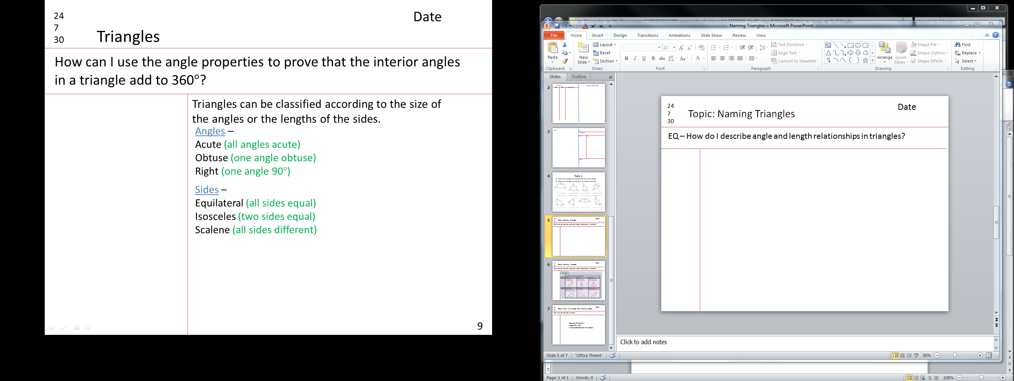
24
7
30
Date
Topic: Naming Triangles
EQ – How do I describe angle and length relationships in triangles?

Slide 6
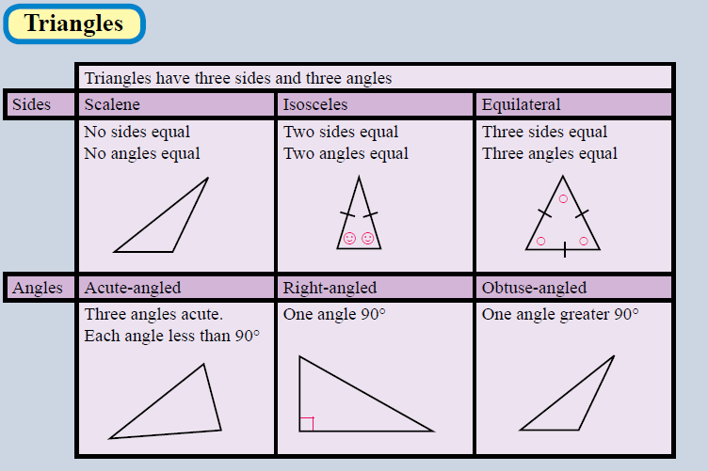
24
7
30
Date
Topic: Naming Triangles
EQ – How do I describe angle and length relationships in triangles?

Slide 7
24
7
30
Date
Topic: Naming Triangles
EQ – How do I describe angle and length relationships in triangles?
Exercise 13.8
Page 182
Worksheet Exercise from Nelson

